Slide 1


Titolo presentazione sottotitolo
Degree course:
Computer Science and Engineering
Milano, XX mese 20XX
Project of Complessità nei sistemi e nelle reti
Balestrieri Niccolò Milan, 7 March 2023

Slide 2

Context and objective of the project activity
Analysis of a graph, in the field of USA politcs:
using the tools provided during the course
Considerations on the results obtained

Slide 3
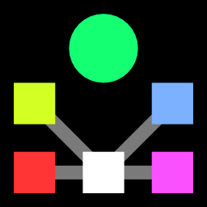
Dataset
Two different datasets were used, provided by the konect website:
Directed graph in csv format, representing a directed network contains front-page hyperlinks between blogs in the context of the 2004 US election
CSV file containing the list of all nodes and their political orientation
To carry out the analysis on the network, various operations were carried out on the two datasets

Slide 4
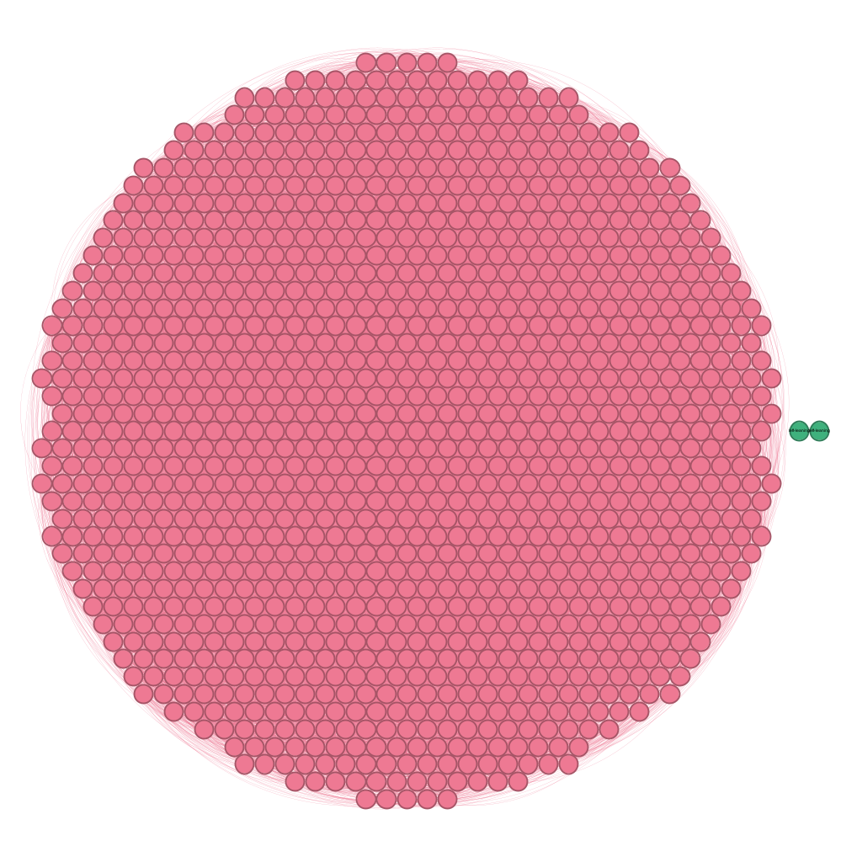
Components
A component is a (maximal) connected subnetwork.
In this case, given that it is a direct network, I calculated the number of the strongly connected components and of the weakly connected components:
SCC = 422
WCC = 2
Pink = SCC
Green = WCC

Slide 5
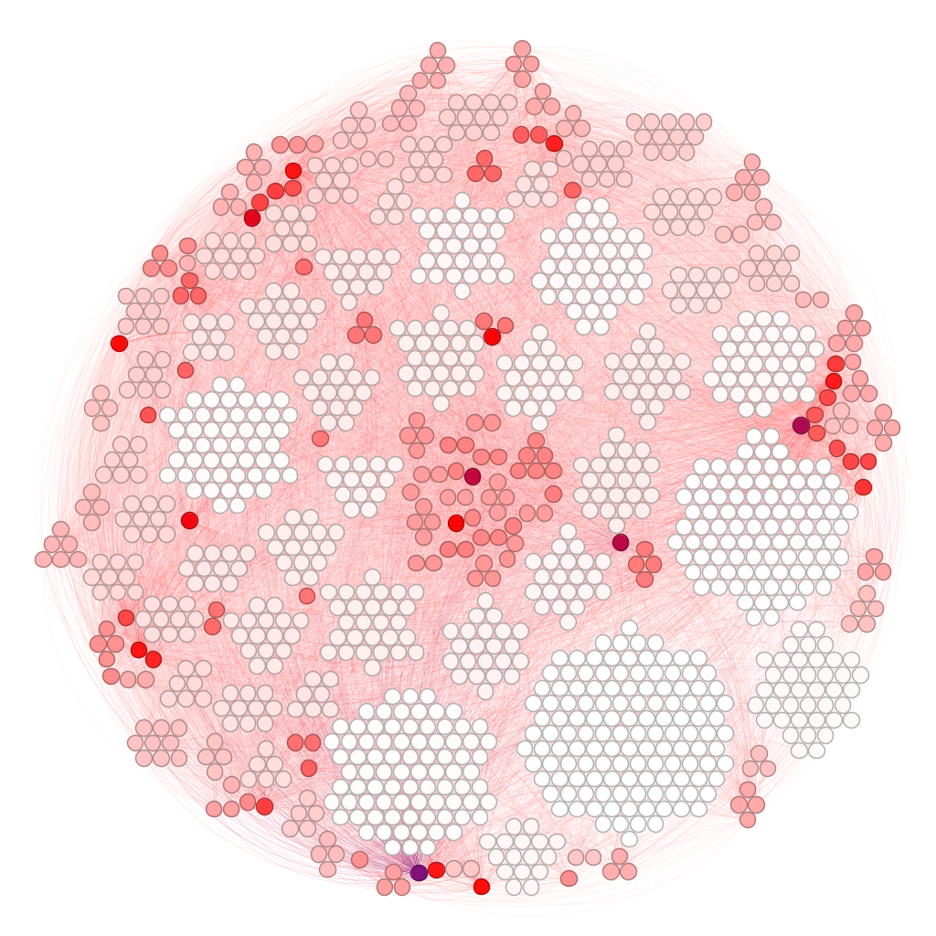
Network properties
A connected network has several properties:
The network diameter is equal to 9
The Average Path length is equal to 3,390
The Average Clustering coefficient is equal to 0,210
This is a direct network so the degree is divided into:
In- degree
Out- degree
Total degree, which is equal to 15,543
The purple node is the one with the highest average degree

Slide 6
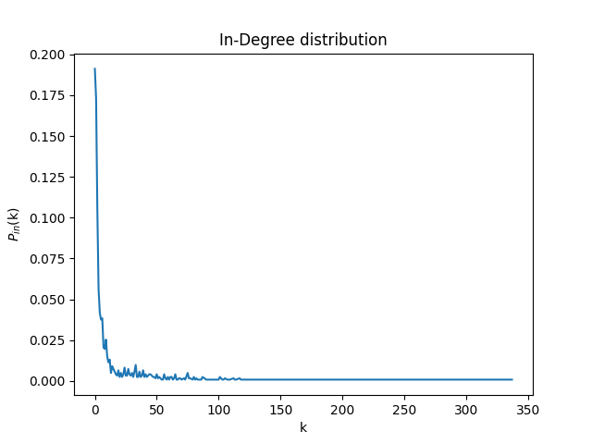
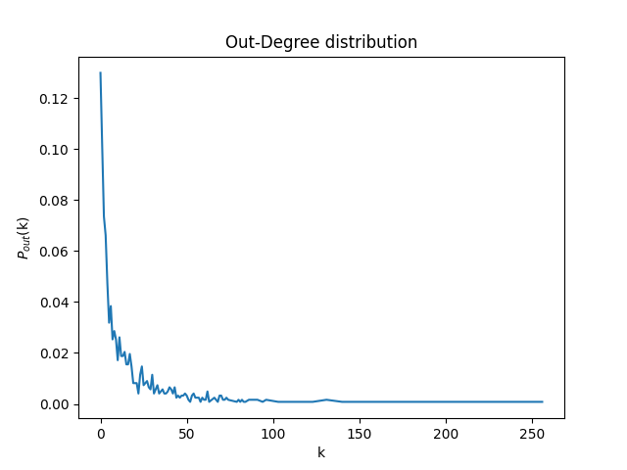
Network properties
I decided to calculate the In- and Out- degree distributions and plot it all
In-degree distribution
Out-degree distribution

Slide 7
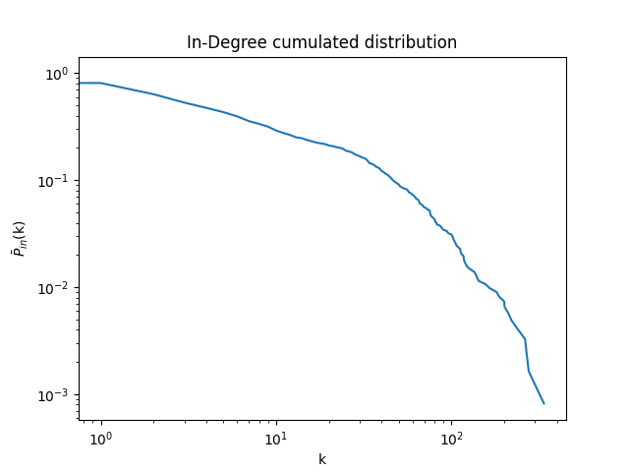
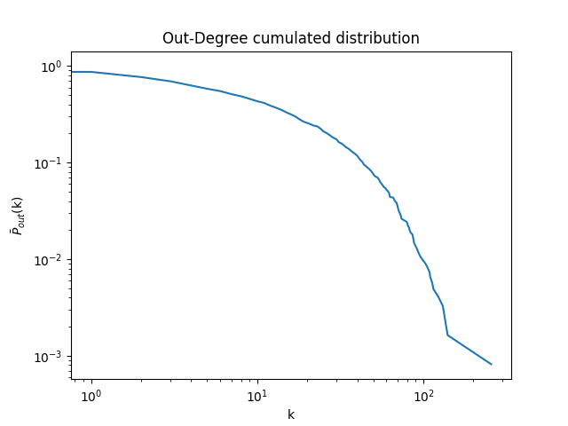
Network properties
Then, i also calculate the In- and Out- degree cumulated distributions and plot it all
In-Degree cumulated distribution
Out-Degree cumulated distribution

Slide 8
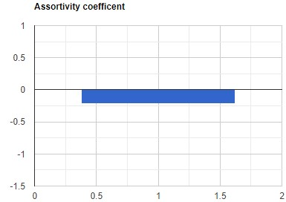
Network properties
To establish if the network was correlated, I decided to calculate the assortivity coefficient
The assortivity coefficient is equal to
-0,210
Network is disassortative

Slide 9
Network model
Scale free

Slide 10
Centralities
Now, the measures of centrality of the network will be reported
Node Centrality

Slide 11
Centralities
Scale free

Slide 12
Centralities
Scale free

